Slide 1
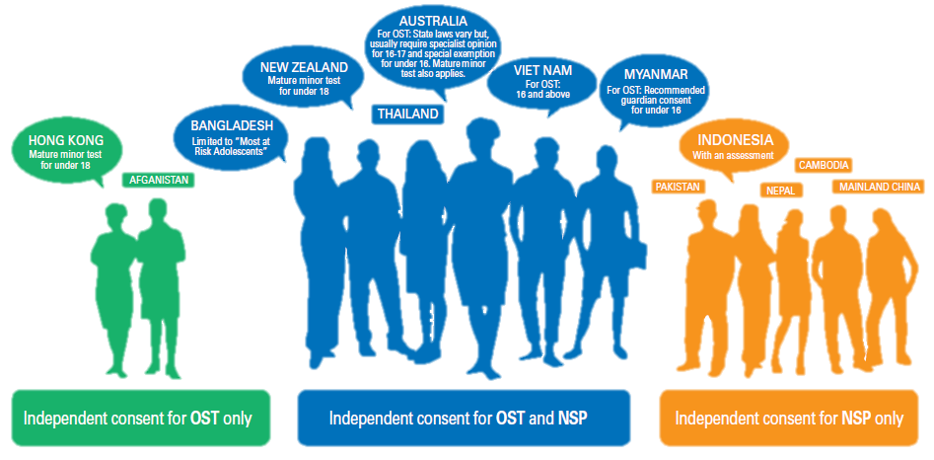
Countries enabling independent consent for young people to access harm reduction services, Asia Pacific
Source: UNICEF, UNESCO, UNFPA, UNODC, Youth LEAD, & Youth Voices Count. (2015). Adolescents Under the Radar in the Asia-Pacific AIDS Response.
Notes:
But we do not know whether these have really increased access among young PWID or not

